Slide 1

Inverse Wave Equation based Generative Modeling
Presentation:
Akhil Sasi Kumar

Slide 2
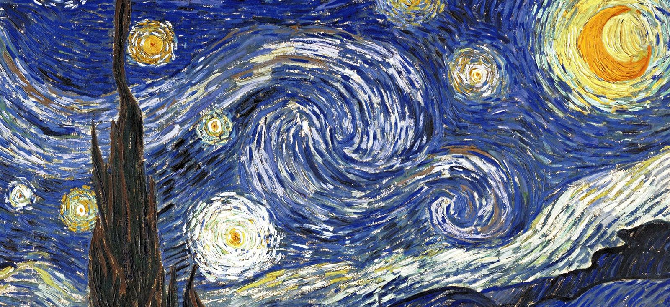
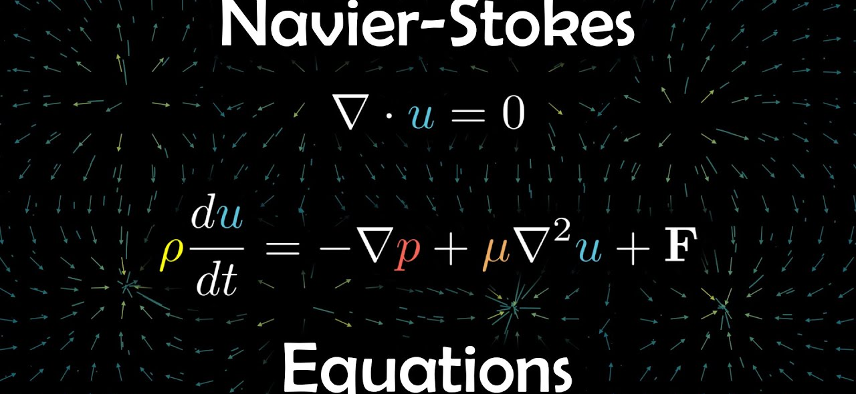
Can Physics be used for Generative modeling?
Yes, Physics itself is a generative model.
Our Universe is arguably a generative model
Our Universe evolves to “generate” ever richer and more complex phenomenon.

Slide 3
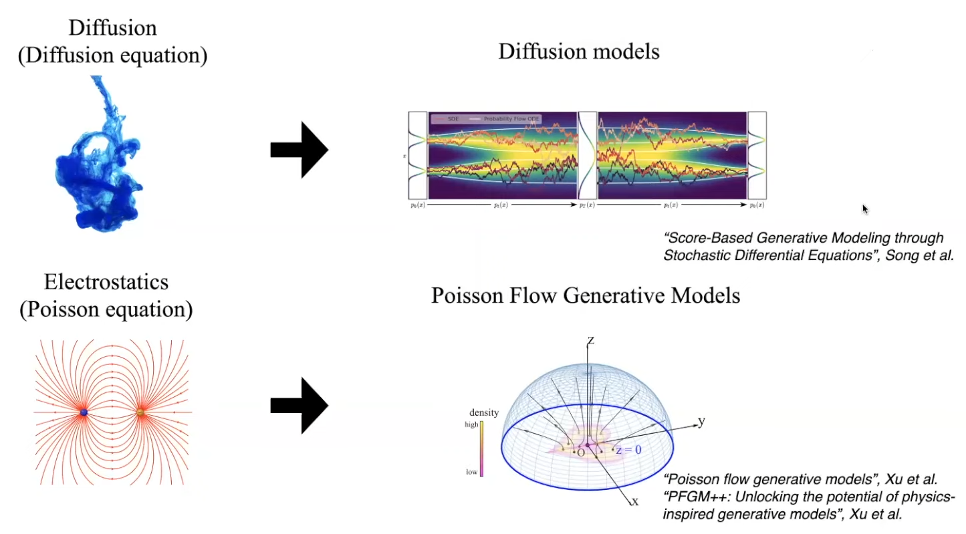
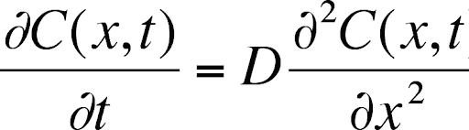
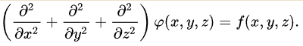
From Physics to Generative models

Slide 4
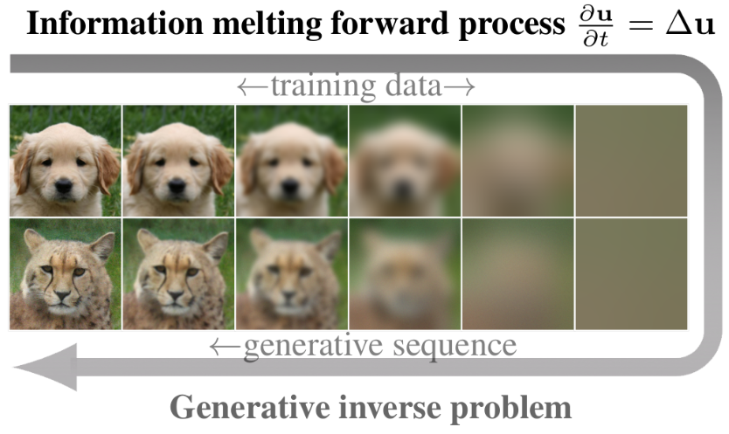

Inverse Heat Equation based Generative Model
https://arxiv.org/abs/2206.13397

Slide 5
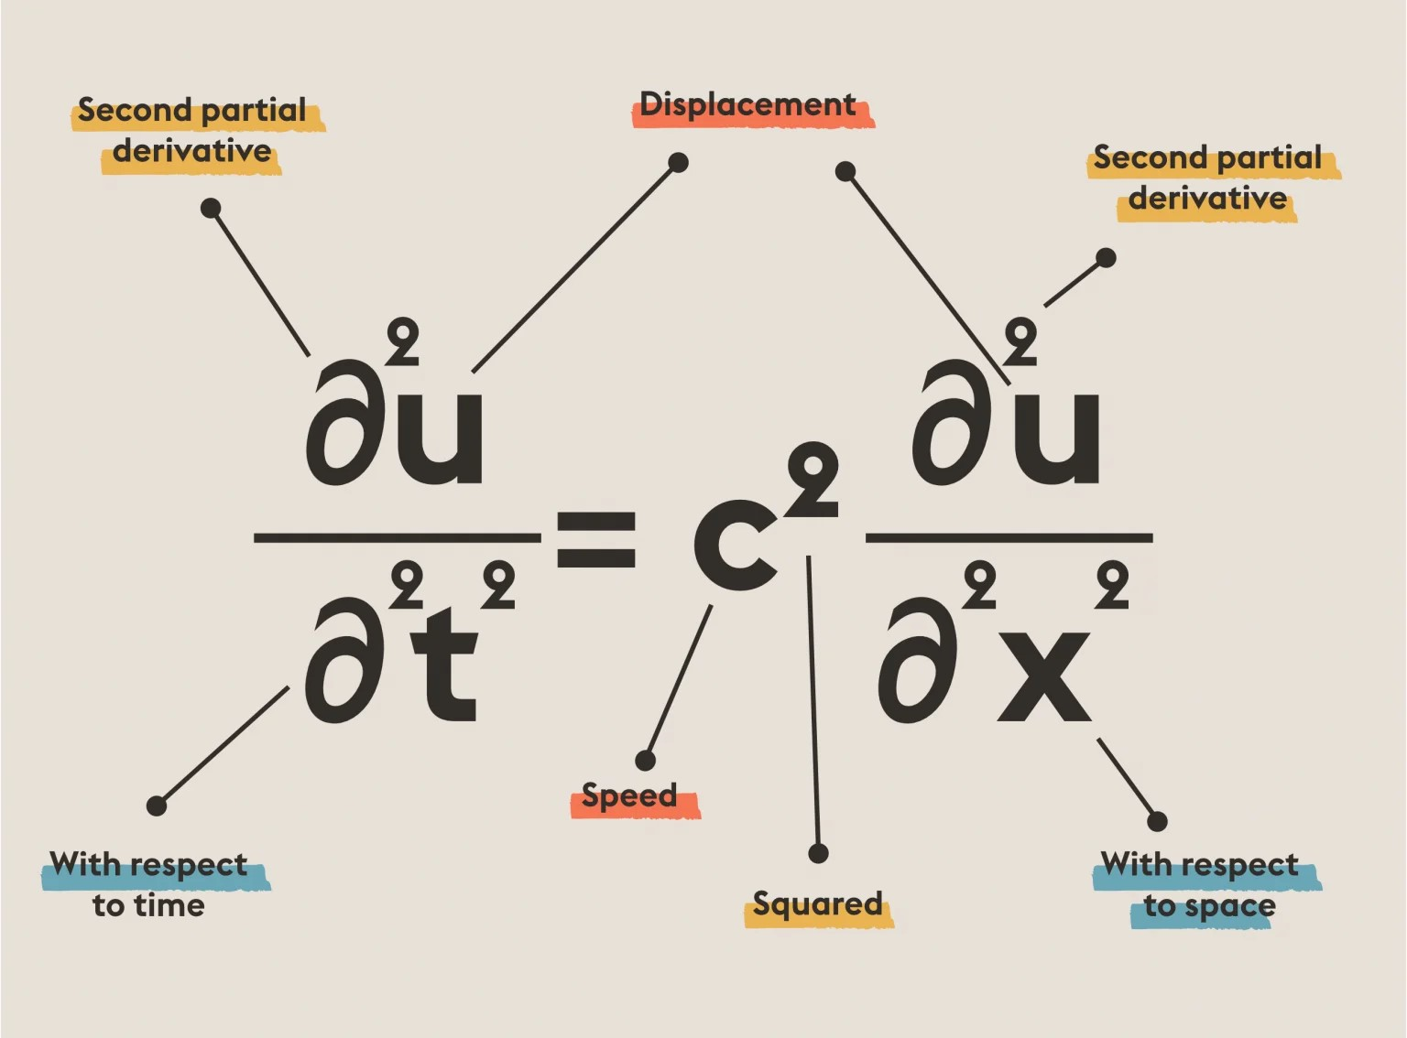
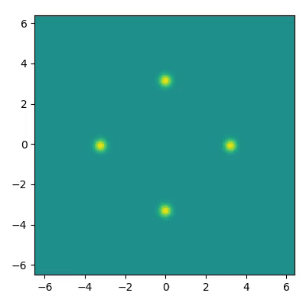
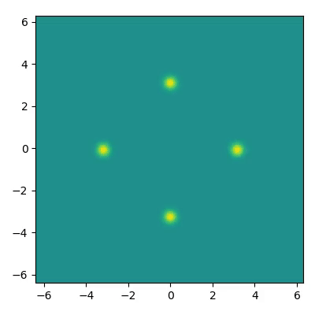

Wave Propagation and Wave Equation
wave propagation in a homogeneous isotropic medium with periodic boundary conditions.
No dispersion, No dissipation
0.05 dispersion, No dissipation
0.05 dispersion, 0.04 dissipation

Slide 6
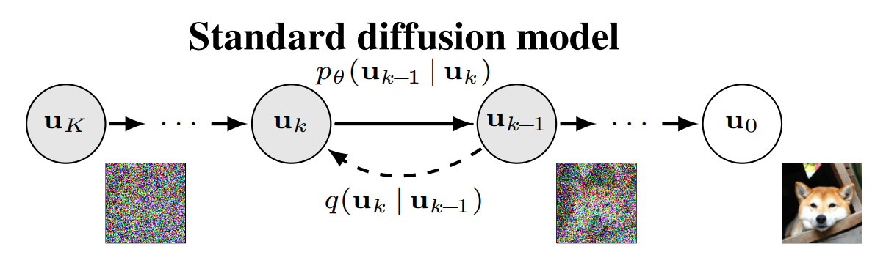
Research Proposal

Slide 7
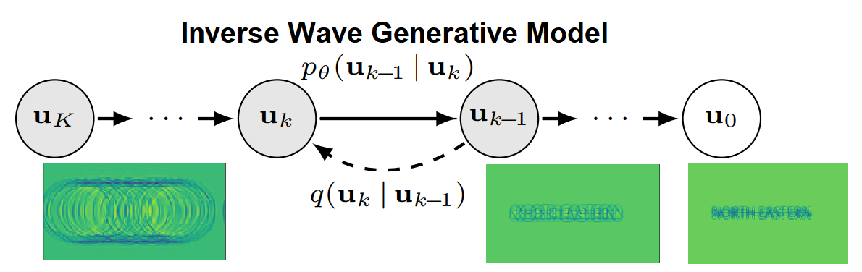

Research Proposal

Slide 8
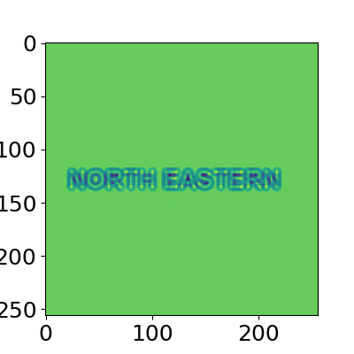
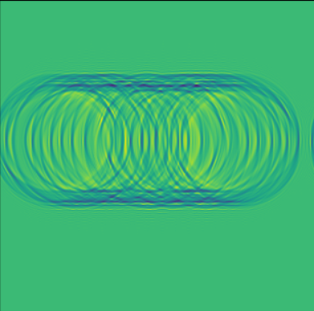
Challenges
Sampling from the model: The evolution of waves towards a prior distribution which must be well defined for sampling.
Prior Distribution right now looks like

Slide 9
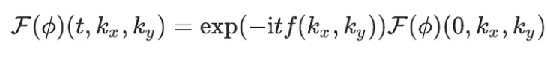
The play of Fourier Transform
Algorithm
Start
Consider the signal at time, t=0
Transform
Apply Fourier transform
Multiply
Multiply with a complex exponential matrix
Inverse-transform
Apply inverse Fourier transform

Slide 10
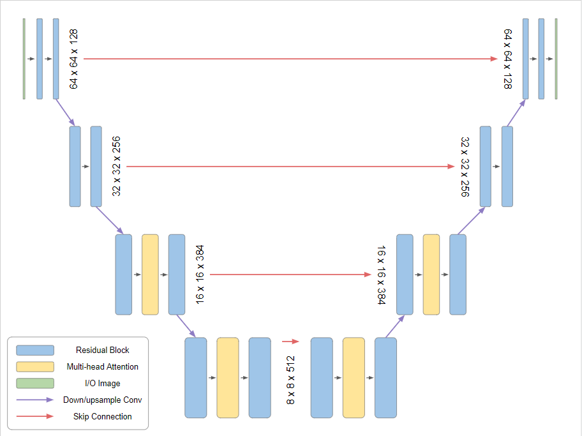
The same old Diffusion UNet Architecture

Slide 11
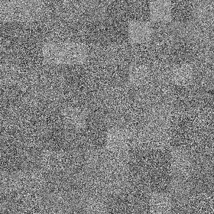

What Diffusion model looks like
What Heat model looks like

Slide 12

Our Results

Slide 13




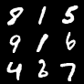
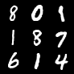
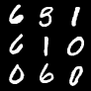
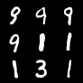

Slide 14
Interpolation

Slide 15
Future Directions
Train on other real-world datasets
What happens to the third channel?
Explore more emergent features
Investigate the complex components in the output
Create conditional variants

Slide 16
Reference
Inverse Heat Equation (https://arxiv.org/pdf/2206.13397.pdf)
Simulating wave propagation with the optical Fourier engine (https://medium.com/optalysys/simulating-wave-propagation-with-the-optical-fourier-engine-f4a9f2e74d28)
GENPHYS: From Physical Processes to Generative Models (https://arxiv.org/pdf/2304.02637.pdf)
Score-Based Generative Modelling through Stochastic Differential Equations (https://openreview.net/pdf?id=PxTIG12RRHS)

